Slide 1
Object-Oriented Programming Part 2
ICS 211
Cam Moore
Information and Computer Sciences
University of Hawaii, Manoa

Slide 2
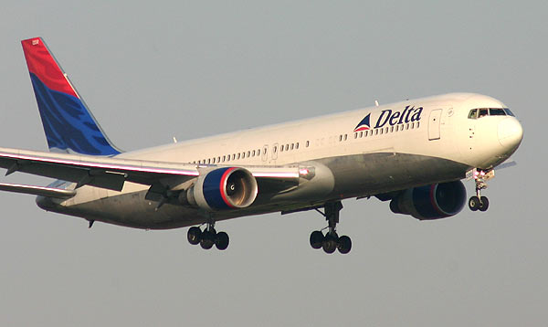
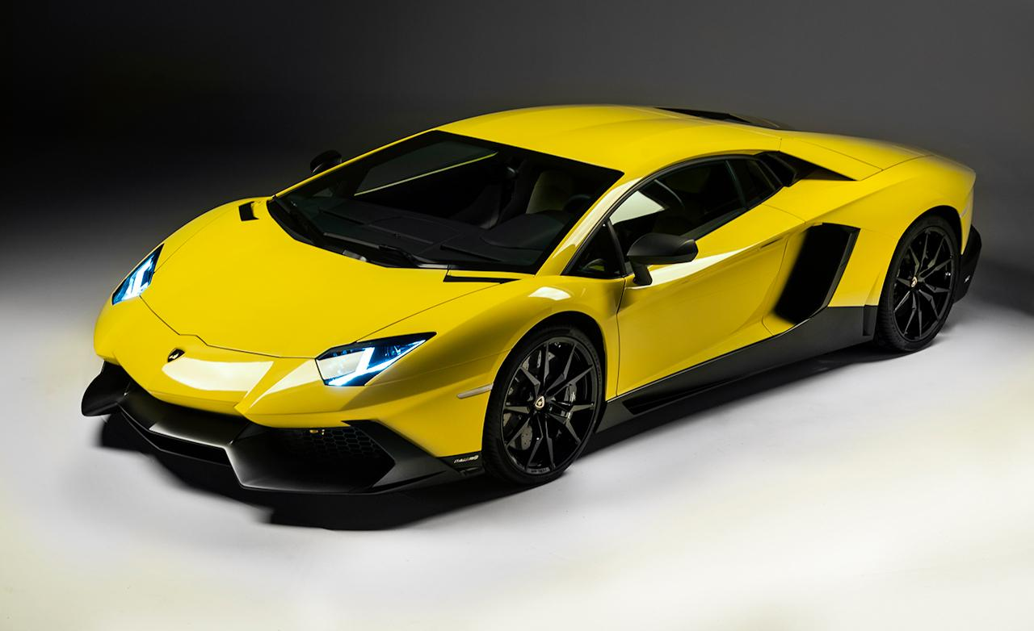
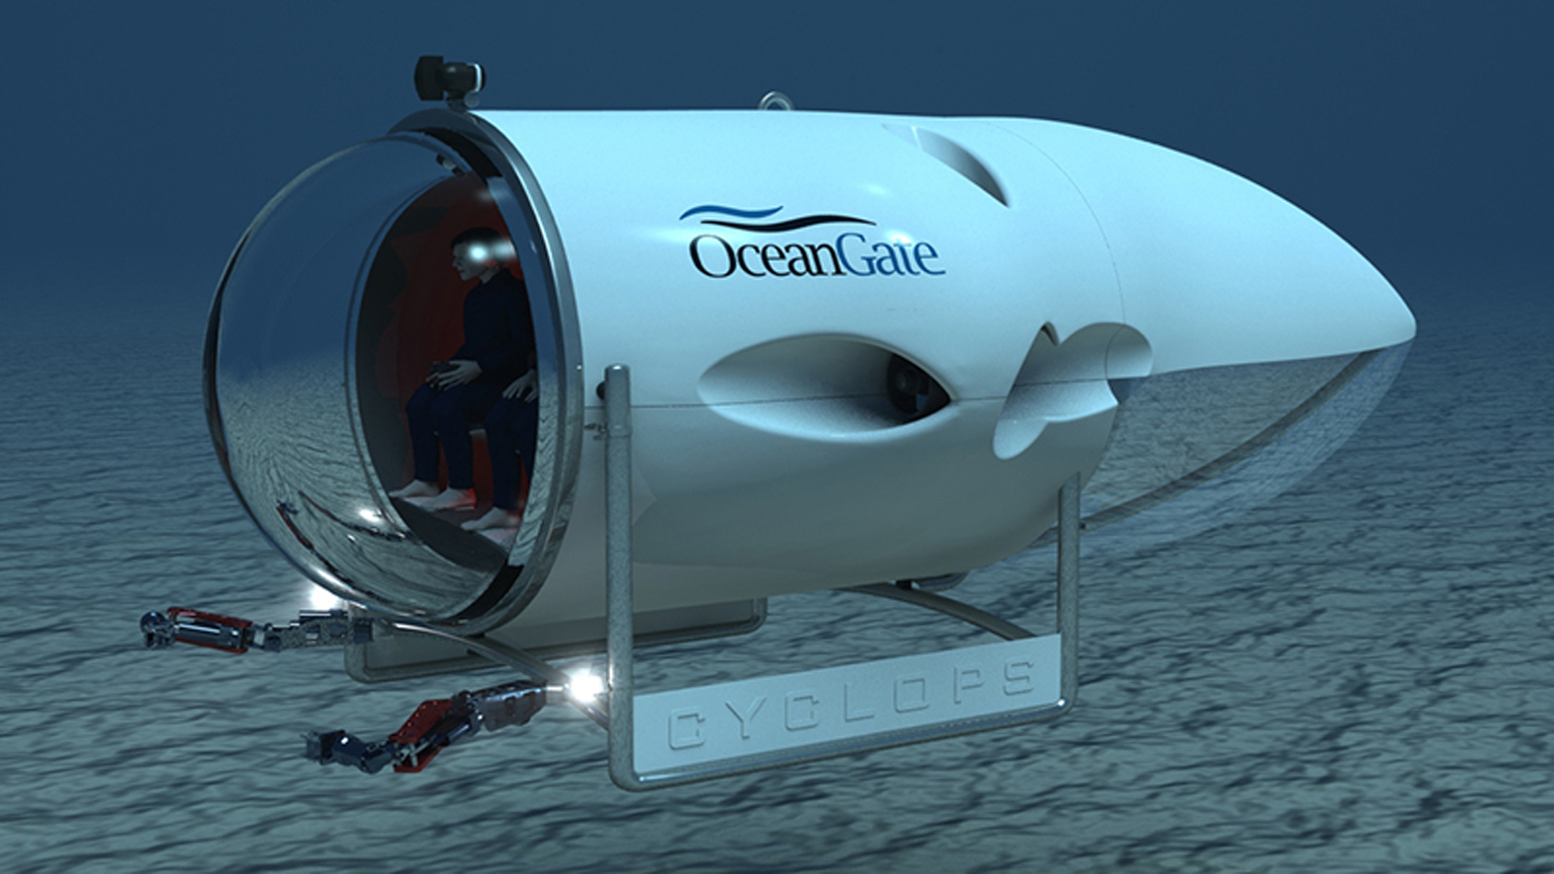
Overriding
Vehicle
move(Position);
move(Position)
move(Position)
move(Position)
Notes:
An encapsulation of data and the methods
Tells you what you can do to the data type
Hides the actual implementation
Provides a reusable abstraction for other programs

Slide 3
Overloading
move(Position)
move(Altitude)
move(Position)
move(Address)
move(Direction, Distance, Speed)
move(Position)
move(Position, Depth)

Slide 4
Polymorphism
Dollars cost(Vehicle)
Dollars cost( ) = 191.5 Million
Dollars cost( ) = 548,000
Dollars cost( ) = ???

Slide 5
Abstract Classes
/** An abstract vehicle.
* @author Cam Moore
*/
public abstract class Vehicle {
/** Move the vehicle to the new position.
* @param p the new Position.
*/
public abstract void move(Position p);
}
Vehicle
move(Position);
/** A Cyclops minisub.
* @author Cam Moore
*/
public class Cyclops extends Vehicle {
/** Move the vehicle to the new position.
* @param p the new Position.
*/
public void move(Position p) {
…
}
}
Notes:
Abstract class – cannot be instantiated.
No constructor
Extend abstract class must implement abstract methods or be abstract
Have constructor

Slide 6
Java Object Class
Object
equals(Object)
?
Class getClass()
int hashCode()
?
?
String toString()

Slide 7
Special Methods
String toString()
Returns a String representation of the instance
Object.toString() returns ‘className@hashCode’
int hashCode()
Returns a hash code value for the instance
boolean equals(Object o)
Returns true if o is equal to this instance
Class getClass()
Returns the class of the instance

Slide 8
Java Exceptions
Object
Throwable
Error
Exception
RuntimeException
NullPointerException
NumberFormatException
ClassCastException
IndexOutOfBoundsException
…
IOException
SQLException
MalformedURLException
…

